Slide 1
University of Basrah Al-zahraa medical college
Ministry of higher Education and Scientific Researches
The module: Molecular, Gene and Diseases
Session 1: Lec.2
Lecture Title:
Amino acids and Protein
Module staff:
Dr. Hussein K. Abdul-Sada
Dr. Nibras S. Al-Ammar
Dr. Ilham Mohammad Jawad
- Dr. Wamedh Hashim Abbas
.
This Lecture was loaded in blackboard and you can find the material in:
(Lippincott’s Illustrated Reviews: Cell and Molecular Biology Chapter 5)
For more detailed instructions, any question, or you have a case you
need help in, please post to the group of session

Slide 2
University of Basrah Al-zahraa medical college
Ministry of higher Education an Scientific Researches
Lecture 2 Learning Outcomes
Recognize and draw the generalized structure of an amino acid (LO 1.6)
Classify amino acids according to the properties of their side chains. (LO 1.7)
Explain how the charges on amino acids are affected by pH. (LO 1.8)
Show how a peptide bond is formed and list its key features. (LO 1.9)
Explain how amino acid charge can influence the isoelectric
point of a protein (LO 1.10)

Slide 3
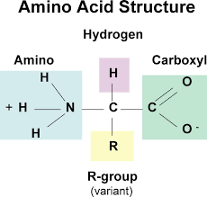
University of Basrah Al-zahraa medical college
Ministry of higher Education an Scientific Researches
Amino acids are the building blocks of proteins.
There are 20 different amino acids that are commonly found in proteins. All are α-amino acids.
They all have a similar structure: a carboxyl group (COO⁻) and an amino group (-NH₃⁺) are covalently bound to a central carbon atom..
(LO 1.6)
There are 20 different R groups.

Slide 4
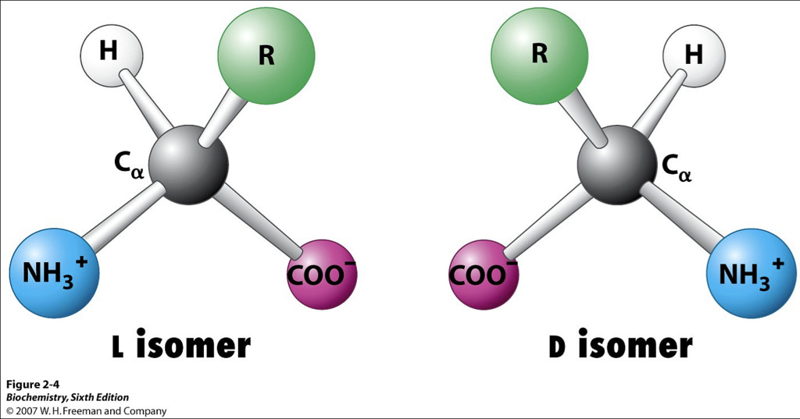
University of Basrah Al-zahraa medical college
Ministry of higher Education an Scientific Researches
Cell can only produce L –Stereoisomers Amino Acid
Why the cell prefers L- amino acids than D-amino acid?.in contrast with Carbohydrate -D is more prefer?.

Slide 5
University of Basrah Al-zahraa medical college
Ministry of higher Education an Scientific Researches
(LO 1.6)
Note: Classification of Amino acid according to polarity
and Charge is your self learning part.

Slide 6
University of Basrah Al-zahraa medical college
Ministry of higher Education an Scientific Researches
Acid-Base Behavior of Amino acids
At low pH an amino acid is in its cationic form with both its amino and carboxyl groups are protonated (NH3+ and COOH).
As the pH rises, the carboxyl group loses its proton and the ampholyte form appear at about pH 6.
With a further increase in pH the amino group (NH3+) is deprotonated, resulting in the anionic form of the molecule.
For example:

Slide 7
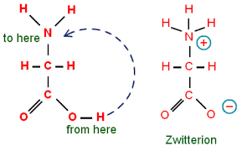
University of Basrah Al-zahraa medical college
Ministry of higher Education an Scientific Researches
The amino acids contain Amino and Carboxyl groups attached to the α-carbon. So it has an acid-base behavior which called
Zwitterion or dipolar ion or ampholyte
In the physiological pH range of 7.35- 7.45, the carboxyl group of an amino acid is dissociated and the amino group is protonated

Slide 8
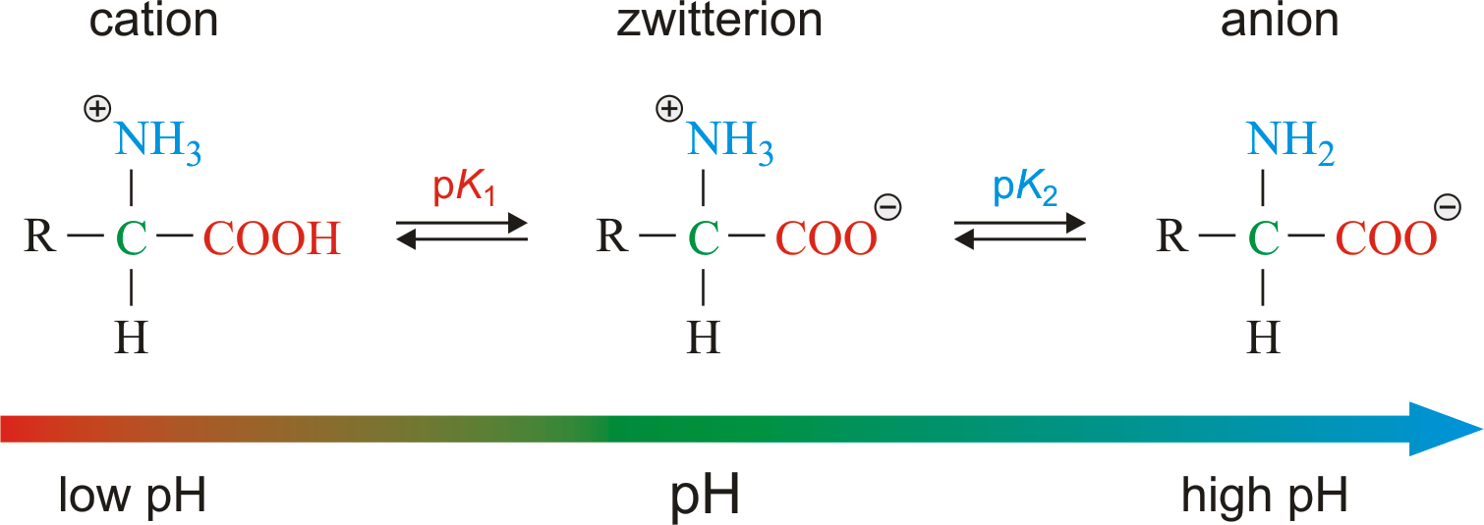
University of Basrah Al-zahraa medical college
Ministry of higher Education an Scientific Researches
At low pH an amino acid is cationic form with both its amino and carboxyl groups are protonated.
When the pH rises, the carboxyl group loses its proton and the ampholyte form appear at about pH 6.
With a further increase in pH the amino group (NH3+) is deprotonated, resulting in the anionic form of the molecule.
8

Slide 9
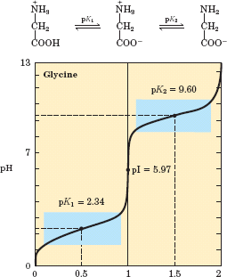
University of Basrah Al-zahraa medical college
Ministry of higher Education an Scientific Researches
LO 18
Titration curve of amino acids without ionizable R groups.
The isoelectric point is the pH at which an amino acid is electrically neutral, in
which the sum of the positive charges equals the sum of the negative charges.
For Glycine, that has only two dissociable hydrogens
(one from the α-carboxyl and one from the α-amino group), the pI is the average of pK1 and pK2
12

Slide 10
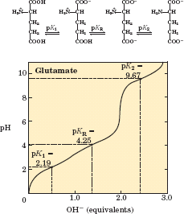
Titration curve of Amino acids with Acidic R groups
LO 1.8
Amino acids with ionizable R groups have additional ionic species, depending on the pH of the medium and the pKa of the R group.
For glutamic acid:
pI is the average of pK1 and pK_{R.}
MGD 2018/ DR. AL-BARQAAWI
10

Slide 11
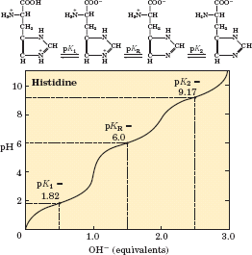
Titration Curve of Amino acids with basic R groups
LO 1.8
For histidine and other basic amino acids:
pI is the average of pK₂ and pK_{R.}
At pH = pI, amino acid bears no net charge and therefore does not move
in an electric field.
MGD 2018/ DR. AL-BARQAAWI
11

Slide 12
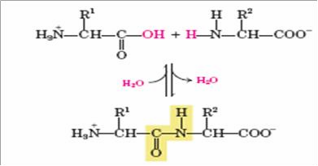
Peptide Bond
LO 1.9
One of the most Important Reactions of Amino Acids is the formation of peptide bond by the condensation of two amino acids.
MGD 2018/ DR. AL-BARQAAWI
15

Slide 13
Key feature of the peptide bond
LO 1.9
All the atoms of the bond are in the same plane.
No rotation about the peptide bonds due to double bond characteristics.
Carbonyl oxygen and Amide hydrogen are in the trans orientation,
because of steric clashes that occur in the cis form.
MGD 2018/ DR. AL-BARQAAWI
16

Slide 14
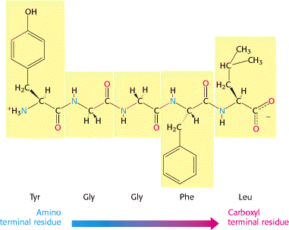
LO 1.9
The peptide has a direction
MGD 2018/ DR. AL-BARQAAWI
14

Slide 15
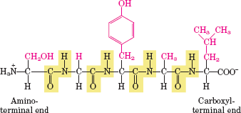
Peptide Nomenclature
LO 1.9
The Peptides are named beginning with the aminoterminal residue, which by convention is placed at the left. For example, the below pentapeptide named. serylglycyltyrosylalanylleucine
MGD 2018/ DR. AL-BARQAAWI
15

Slide 16
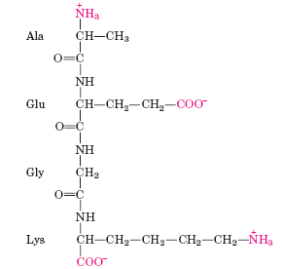
Ionization of peptide
LO 1.10
Alanylglutamylglycyllysine.
This tetrapeptide has one free -amino group, one free -
carboxyl group, and two ionizable R groups. The
groups ionized at pH 7.0 are in red
MGD 2018/ DR. AL-BARQAAWI
16

Slide 17
Proteins
LO 1.10
Proteins are polypeptides of 20 different amino acids, in a sequence encoded by the gene
The polypeptide chain folds into a complex and highly specific three- dimensional structure, determined by the sequence of amino acids
The folding of proteins depends on the chemical and physical properties of the amino acids
The amino acids that make up a protein contribute to the folding and function of that protein. The side chains those of the amino acids are more important in a polypeptide as they contribute to the charge seen on the protein.
MGD 2018/ DR. AL-BARQAAWI
17

Slide 18
Isoelectric Point (pI) Of Protein
The isoelectric point (pI) is the pH at which a protein has no overall net charge, so can not move in electrical feild.
Acidic proteins contain many negatively charged amino acids and have a low pI.
Basic proteins contain many positively charged amino acids and have a high pI.
MGD 2018/ DR. AL-BARQAAWI
18

Slide 19
Questions
Q1/ Amino acids can be classified into the following classes according to R groups
Non polar, aliphatic
Aromatic
Polar, uncharged
Positively Charged (Basic)
Negatively Charged (Acidic)
Put the name of amino acids under each of the above classes.
MGD 2018/ DR. AL-BARQAAWI
19

Slide 20
Questions
Q2/ draw the ionization states of the amino acids:
Cysteine
Lysine
Aspartic acid
Isoleucine
Q3/ predict the effect of the mutation of amino acid alanine to glutamic acid, in the protein albumin, regarding its pI
MGD 2018/ DR. AL-BARQAAWI
20

Slide 21
University of Basrah Al-zahraa medical college
Ministry of higher Education an Scientific Researches

